Slide 1
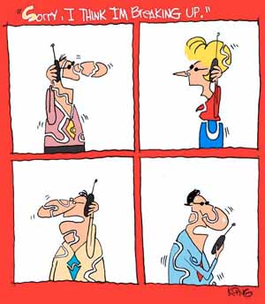
EE359 – Lecture 2 Outline
Announcements
1st HW posted, due next Friday at 4pm.
Discussion section and TA OHs starts next week
Will finalize makeup lecture schedule today
Review of Last Lecture
TX and RX Signal Models
Path Loss Models
Free-space and 2-Ray Models
General Ray Tracing
Single-Slope Path Loss Exponent Model
Empirical Models
mmWave Models

Slide 2
Makeup lecture options
Next Thursday
Monday (1/13): 11:30-12:50pm w/lunch
Tuesday (1/14): 3:00-4:20 or 4:30-5:50pm (+lecture 1:30-2:50)
Wednesday (1/15): 9:00-10:20am or 11:30-12:50pm*
Regular Time Thu 1:30-2:50pm with Tom giving lecture
Friday (1/17): 9:00-10:20am* or 3:30-4:50pm
Following Monday is MLK 3-day weekend
Thu 2/20 moved to Fri 2/21 from 3:30-4:50pm
MT week, could do Fri 9am instead
Tue 2/4 moved to Wed 2/5 11:30-12:50pm w/lunch
Thu 3/5 moved to Wed 3/4 11:30-12:50pm w/lunch
Could do Wed am or Friday 9am or 3:30 instead
Regular time
with Tom
*Pending availability

Slide 3
Lecture 1 Review
Course Information
Wireless Vision
Technical Challenges
Current/Next-Gen Wireless Systems
Spectrum Regulation and Standards
Emerging Wireless Systems
Emerging systems can be covered in a bonus lecture

Slide 4

Propagation Characteristics
Path Loss (includes average shadowing)
Shadowing (due to obstructions)
Multipath Fading
Slow
P_{t}
P_{r}/P_{t}
Fast
P_{r}
Very slow
v
d=vt
d=vt

Slide 5
Path Loss Modeling
Maxwell’s equations
Complex and impractical
Free space and 2-path models
Too simple
Ray tracing models
Requires site-specific information
Single-slope path loss exponent model
Main characteristics: good for high-level analysis
Measurement-based and Standards Models
Not accurate; used to assess different designs

Slide 6
Free Space (LOS) Model
d=vt
Path loss for unobstructed LOS path
Power falls off :
Proportional to 1/d²
Proportional to λ² (inversely proportional to f²)
This is due to the effective aperture of the antenna

Slide 7
Two Ray Model
Path loss for one LOS path and 1 ground (or reflected) bounce
Ground bounce approximately cancels LOS path above critical distance
Power falls off
Proportional to d² (small d)
Proportional to d⁴ (d>d_{c})
Independent of λ (f_{c})
Two-path cancellation equivalent to 2-element array, i.e. the effective aperature of the receive antenna is changed.

Slide 8

General Ray Tracing
Models signal components as particles
Reflections
Scattering
Diffraction
Requires site geometry and dielectric properties
Easier than Maxwell (geometry vs. differential eqns)
Computer packages often used
Reflections generally dominate
10-ray reflection model explored in HW

Slide 9
Simplified Path Loss Model
Used when path loss dominated by reflections.
Most important parameter is the path loss exponent γ, determined empirically.
r

Slide 10
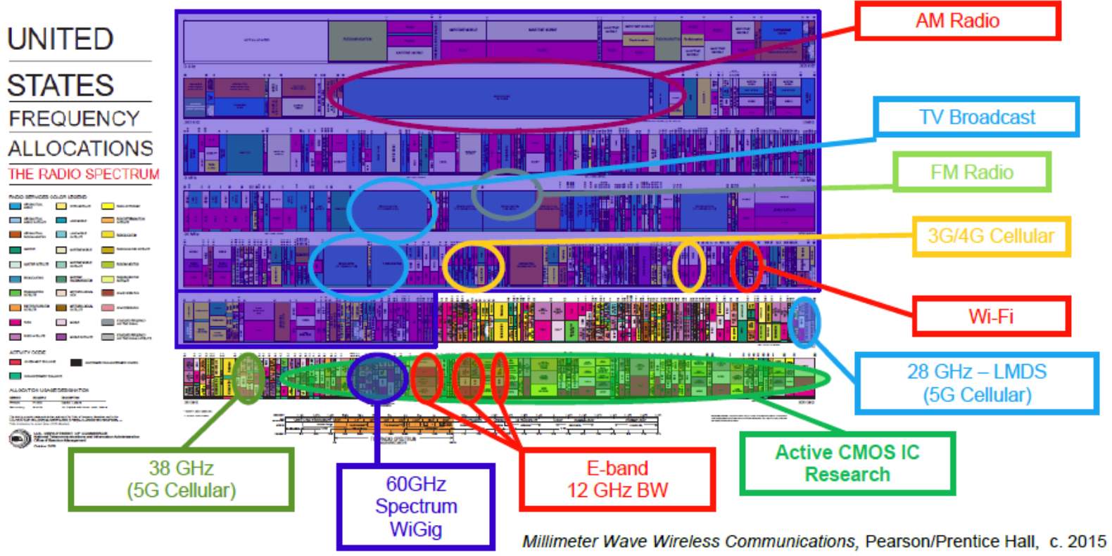
mmWave: What’s the big deal?
All existing commercial systems fit into a small fraction of the mmWave band

Slide 11

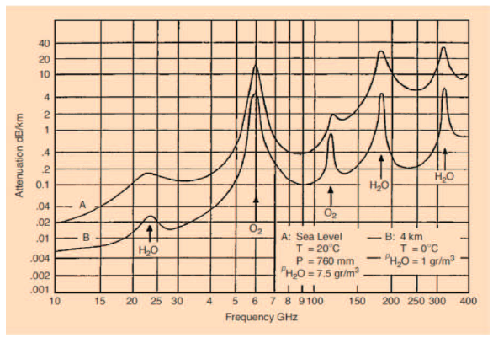
mmWave Propagation (60-100GHz)
mmW
Massive
MIMO
Channel models immature
Based on measurements, few accurate analytical models
Path loss proportion to λ² (huge)
Also have oxygen and rain absorbtion
λ is on the order of a water molecule
mmWave systems will be short range or require “massive MIMO”

Slide 12
Empirical Channel Models (not covered in lecture, not on HW/exams)
Early cellular empirical models:
Empirical path loss models for early cellular systems were based on extensive measurements.
Okumura model: empirically based (site/freq specific), uses graphs
Hata model: Analytical approximation to Okumura
Cost 231 Model: extends Hata to higher freq. (2 GHz)
Multi-slope model
Walfish/Bertoni: extends Cost 231 to include diffraction
Current cellular models (LTE and 5G):
Detailed path loss models for UE (3GPP TS 36.101) and base stations (3GPP TS 36.104) for different multipath delay spreads, user speeds and MIMO antenna correlations.
The 5G model includes higher frequencies (up to 100 GHz).
WiFi channel models: TGn and TGac
Indoor and outdoor path loss models with MIMO (4x4 & greater), 40 MHz channels (& greater), and different multipath delay spread.
Commonly used in cellular and WiFi system simulations

Slide 13
Main Points
Path loss models simplify Maxwell’s equations
Models vary in complexity and accuracy
Power falloff with distance is proportional to d² in free space, d⁴ in two path model
Main characteristics of path loss captured in single-slope exponent model P_{r}=P_{t}K[d_{r}/d]^{γ}
mmWave propagation models still immature
Path loss large due to frequency, rain, and oxygen
Empirical models used in simulations

